Slide 1
Arduino 2020 VHS

Slide 2
HARDWARE

Slide 3
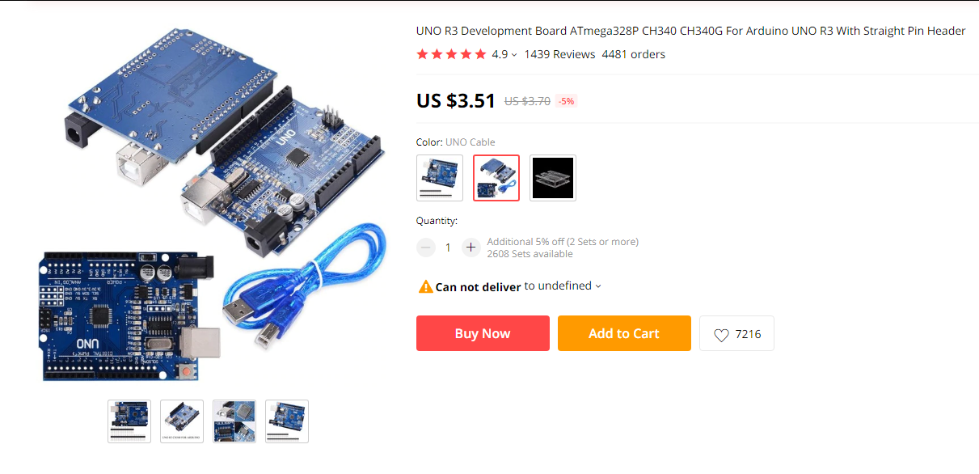

Slide 4
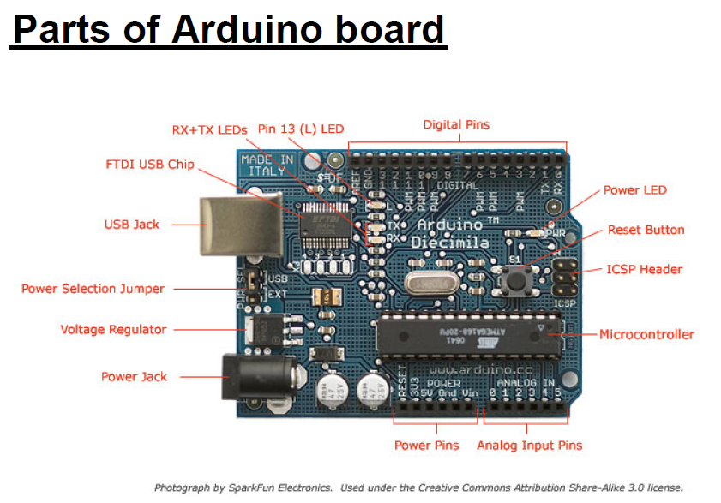

Slide 5
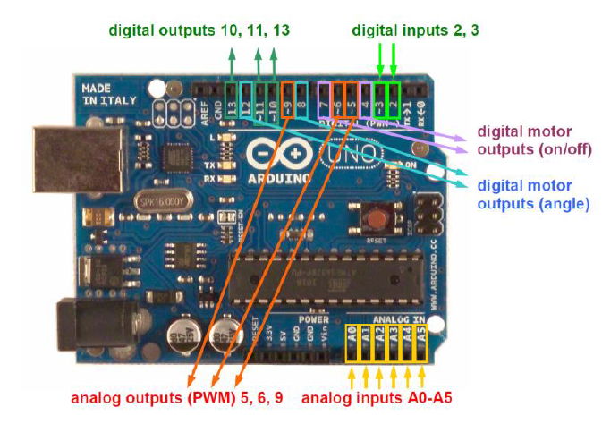

Slide 6
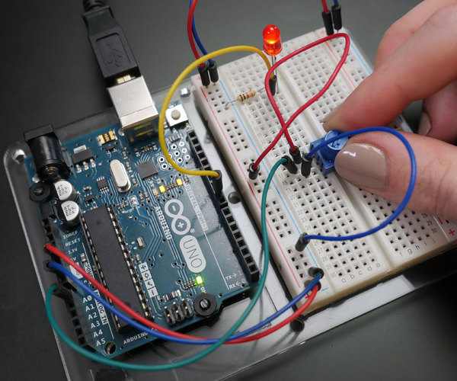

Slide 7
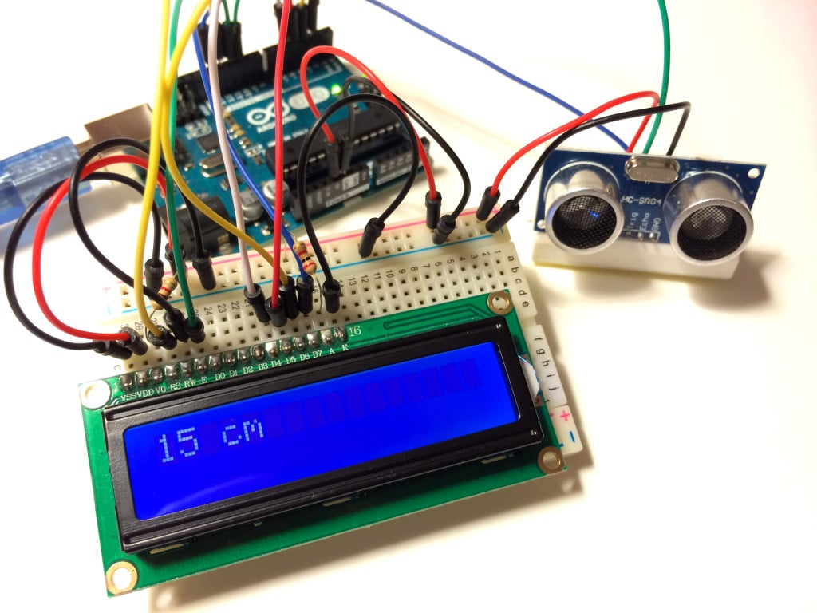

Slide 8
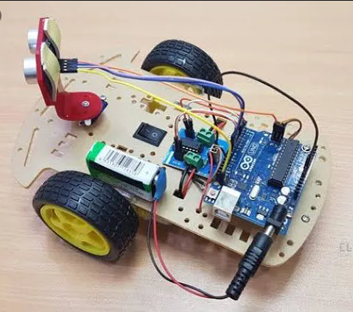

Slide 9
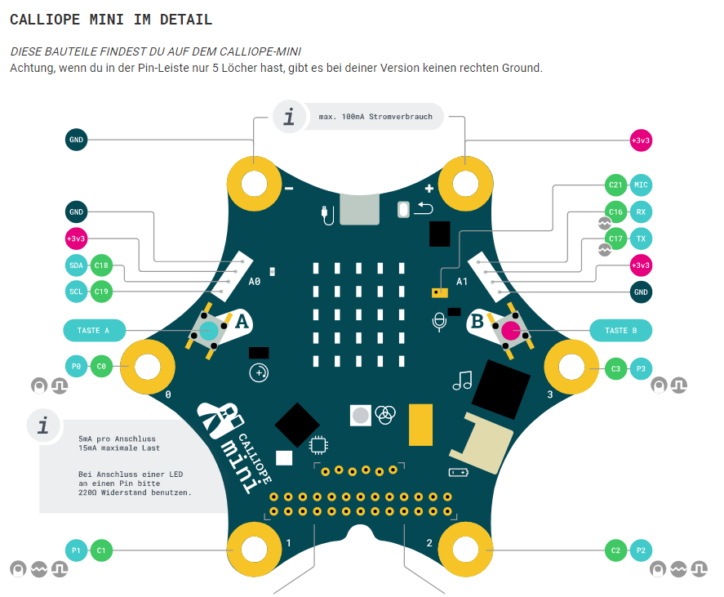

Slide 10

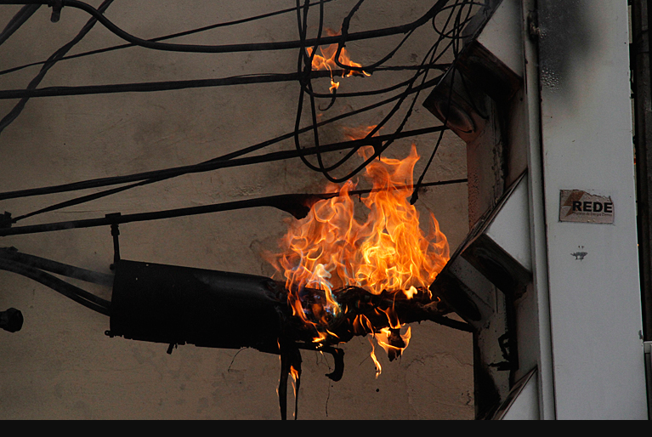
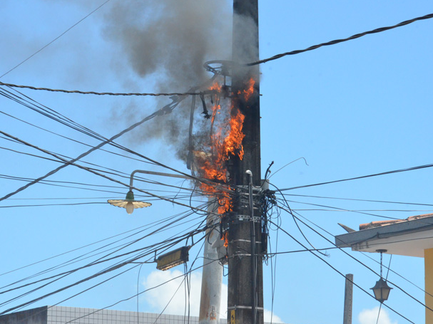

Slide 11
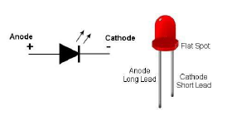

Slide 12
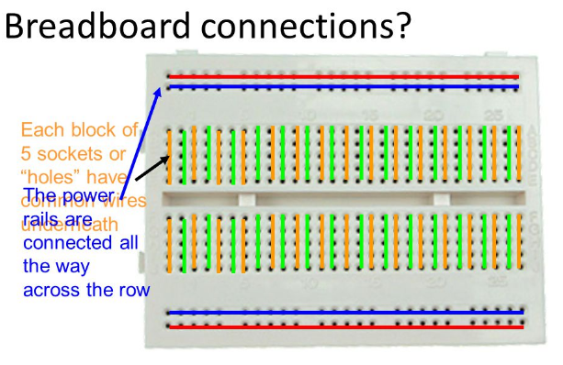

Slide 13
PROGRAMMIERUNG
( 50 - 50 )

Slide 14
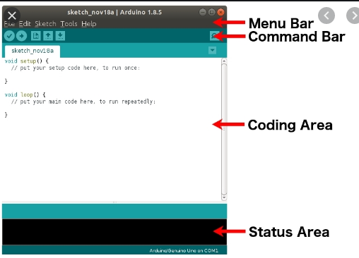
https://www.arduino.cc/en/Main/Software
https://www.arduino.cc/en/Tutorial/BuiltInExamples

Slide 15
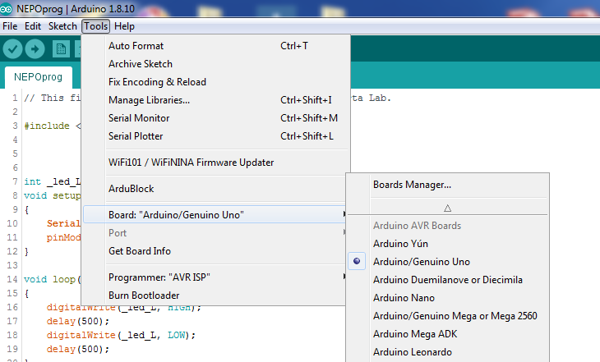

Slide 16
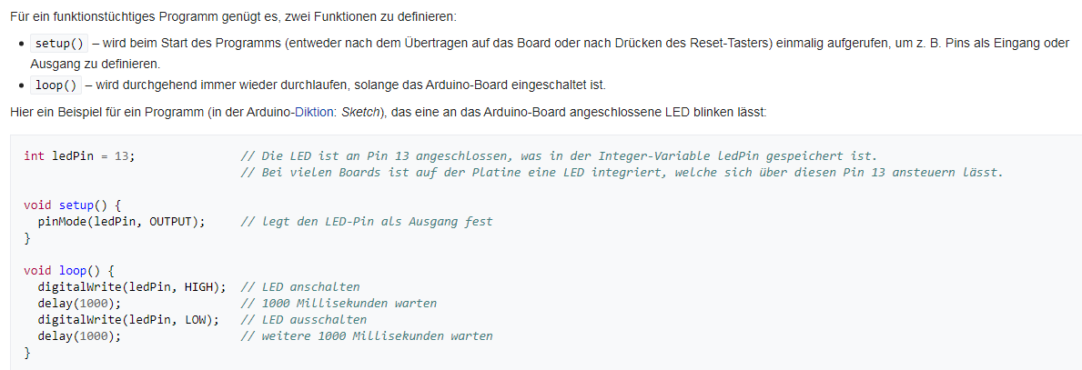

Slide 17
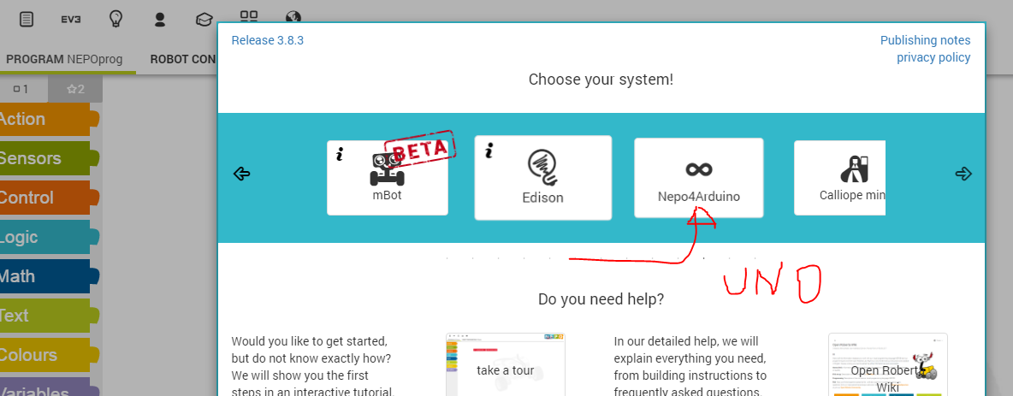
https://lab.open-roberta.org/

Slide 18
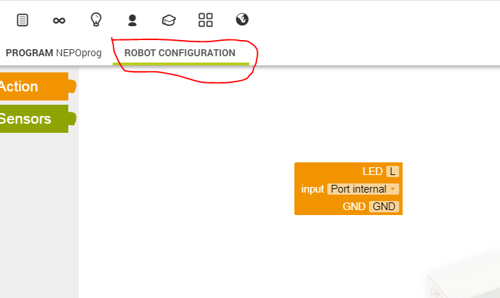

Slide 19
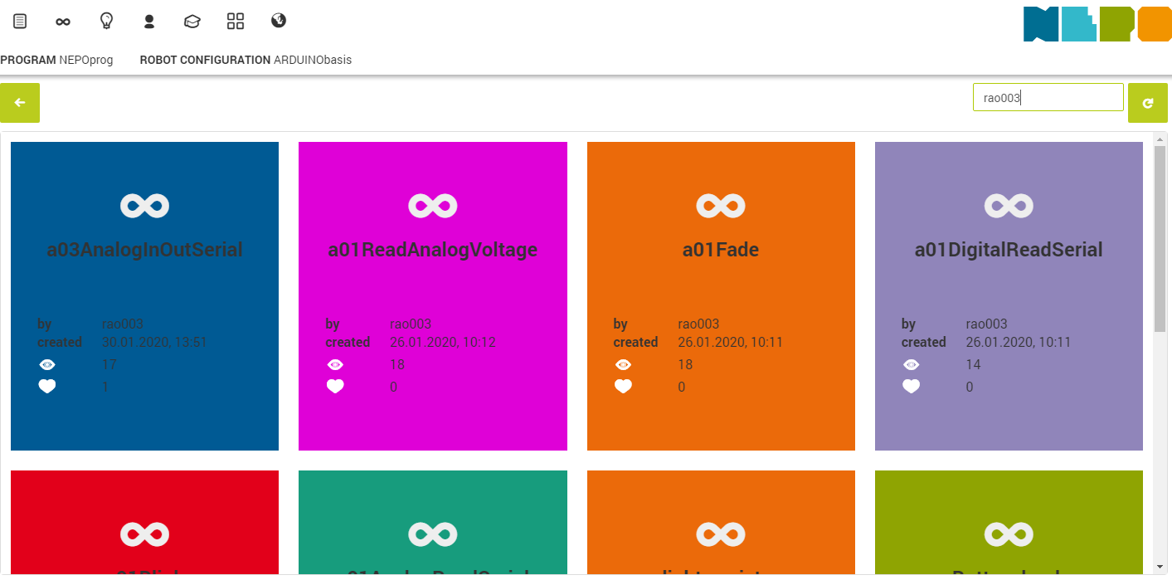

Slide 20
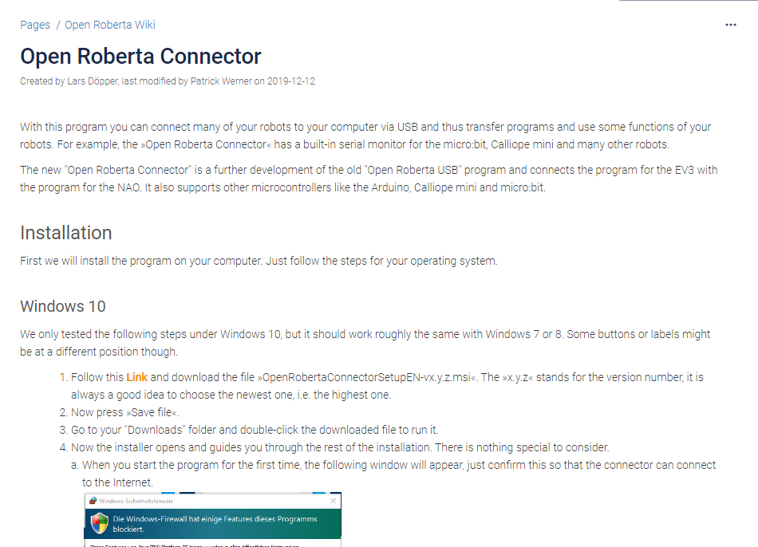
https://jira.iais.fraunhofer.de/wiki/display/ORInfo/Open+Roberta+Connector

Slide 21
Hardware + Software

Slide 22
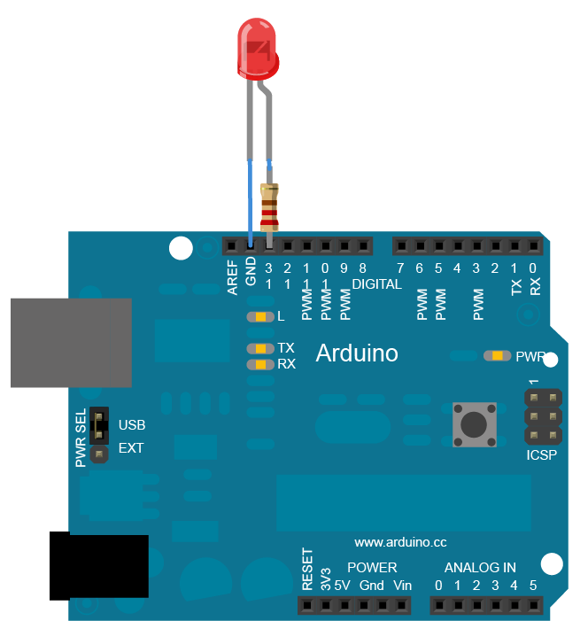
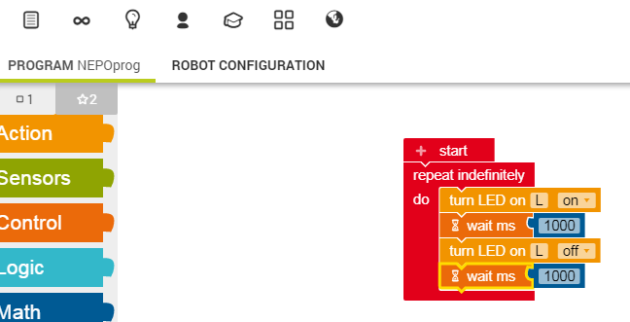
// the setup function runs once when you press reset or power the board void setup() { // initialize digital pin LED_BUILTIN as an output. pinMode(LED_BUILTIN, OUTPUT); } // the loop function runs over and over again forever void loop() { digitalWrite(LED_BUILTIN, HIGH); // turn the LED on (HIGH is the voltage level) delay(1000); // wait for a second digitalWrite(LED_BUILTIN, LOW); // turn the LED off by making the voltage LOW delay(1000); // wait for a second }

Slide 23
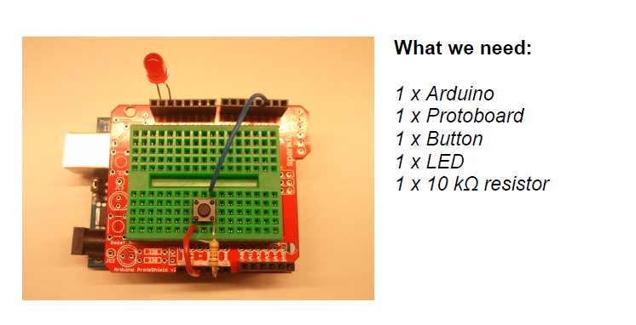

Slide 24
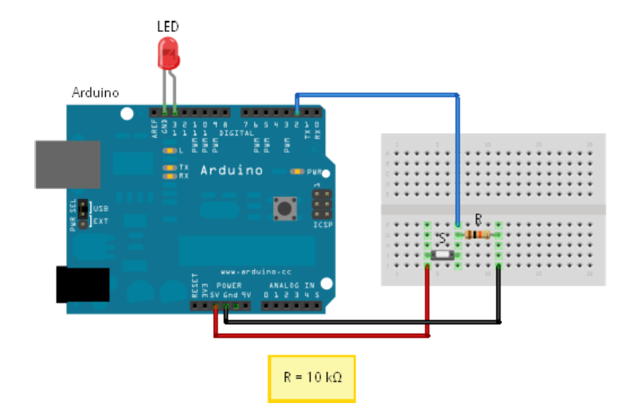

Slide 25
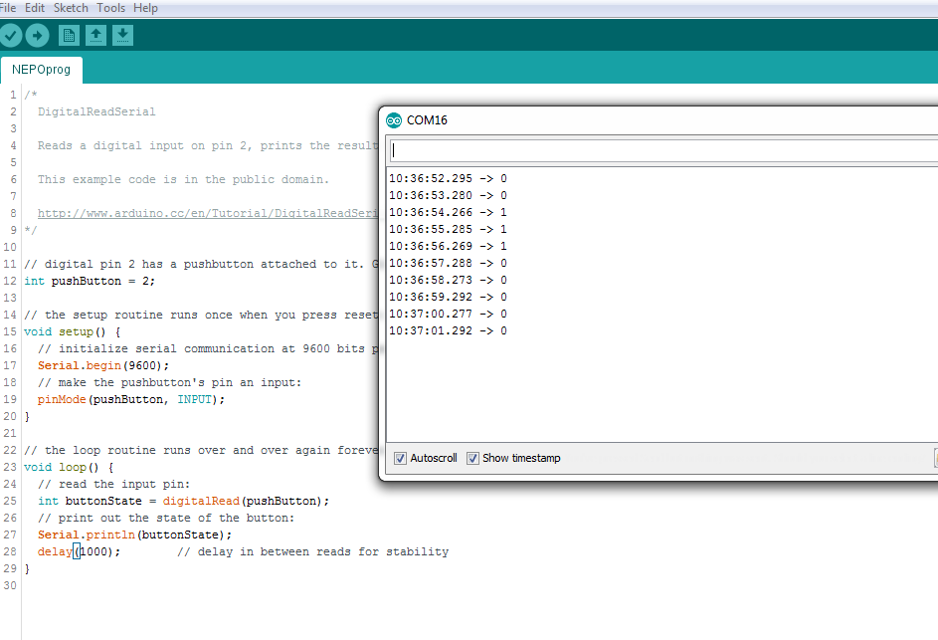

Slide 26
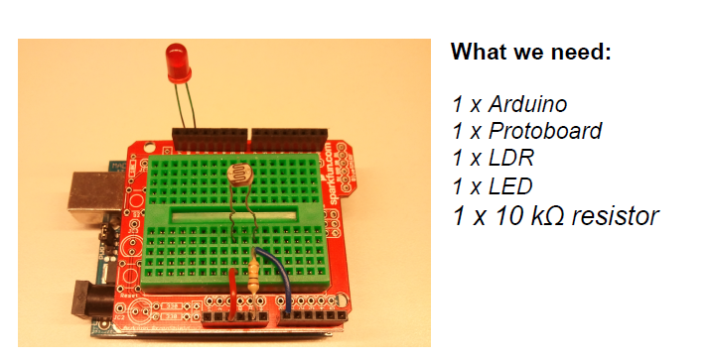

Slide 27
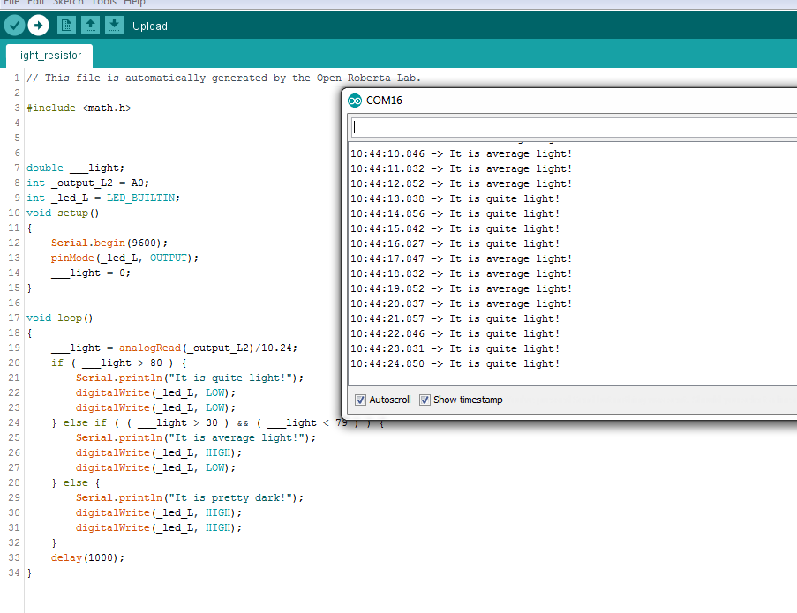

Slide 28
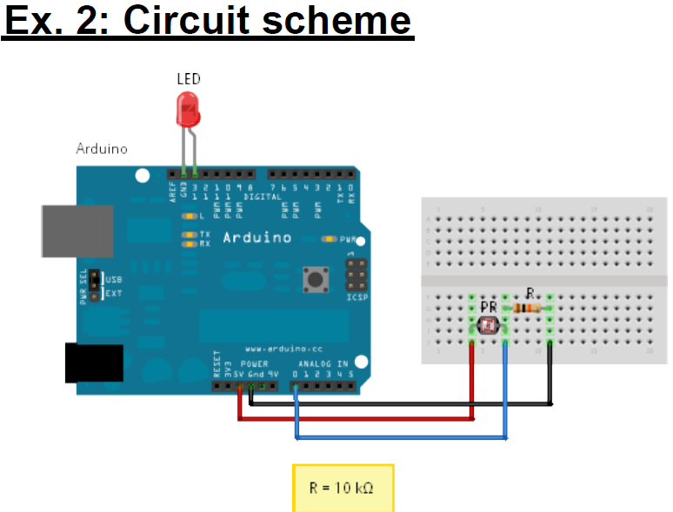

Slide 29
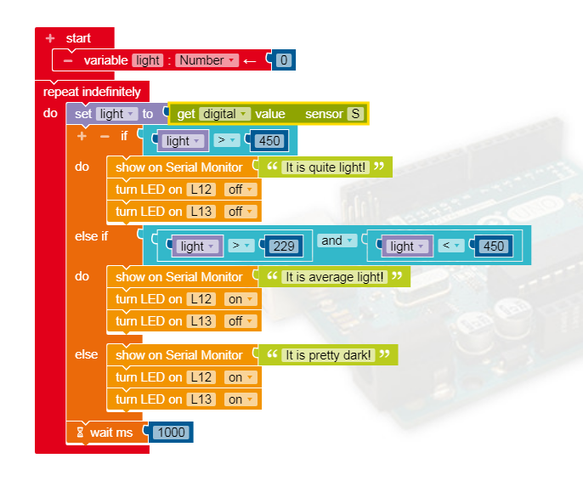

Slide 30
int light = 0; // store the current light value
void setup() {
// put your setup code here, to run once:
Serial.begin(9600); //configure serial to talk to computer
pinMode(13, OUTPUT); // configure digital pin 13 as an output
pinMode(12, OUTPUT); // configure digital pin 12 as an output
}
void loop() {
// put your main code here, to run repeatedly:
light = analogRead(A0); // read and save value from PR
Serial.println(light); // print current light value
if(light > 450) { // If it is bright...
Serial.println("It is quite light!");
digitalWrite(13,LOW); //turn left LED off
digitalWrite(12,LOW); // turn right LED off
}
else if(light > 229 && light < 451) { // If it is average light...
Serial.println("It is average light!");
digitalWrite(13, HIGH); // turn left LED on
digitalWrite(12,LOW); // turn right LED off
}
else { // If it's dark...
Serial.println("It is pretty dark!");
digitalWrite(13,HIGH); // Turn left LED on
digitalWrite(12,HIGH); // Turn right LED on
}
delay(1000); // don't spam the computer!
}

Slide 31
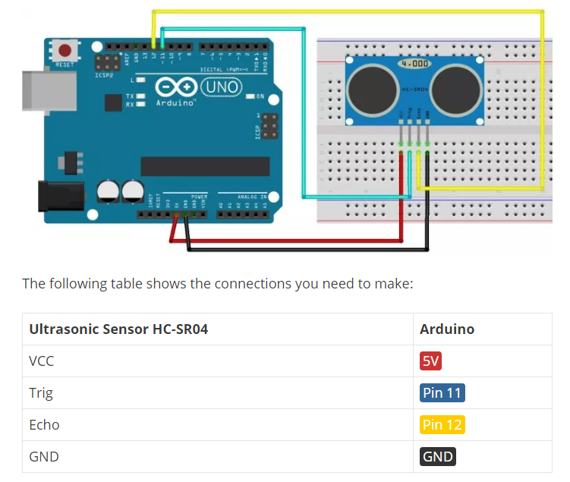

Slide 32
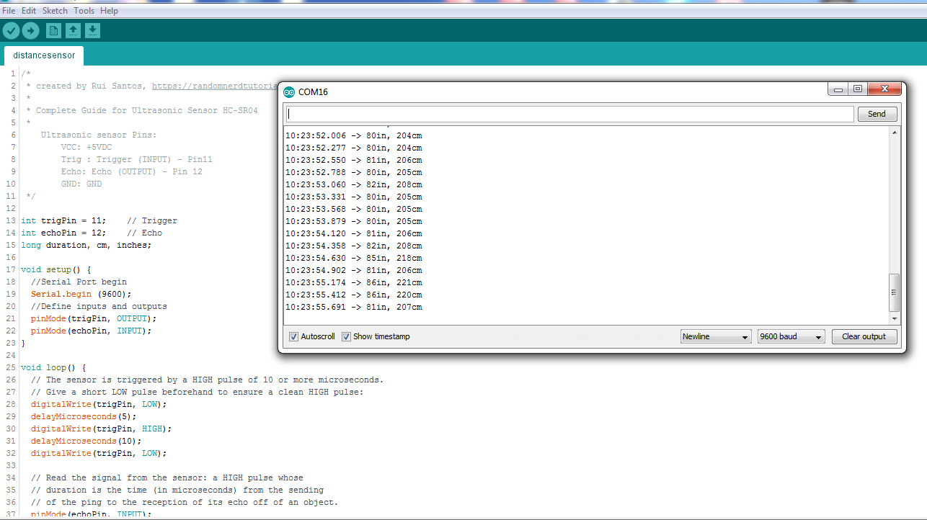

Slide 34
your turn !!!

Slide 35
https://pimylifeup.com/arduino-light-sensor/

Slide 36
https://create.arduino.cc/projecthub/tarantula3/using-an-ldr-sensor-with-arduino-807b1c
https://highvoltages.co/tutorial/arduino-tutorial/traffic-signal-using-arduino-and-ultrasonic-sensor/

Slide 37
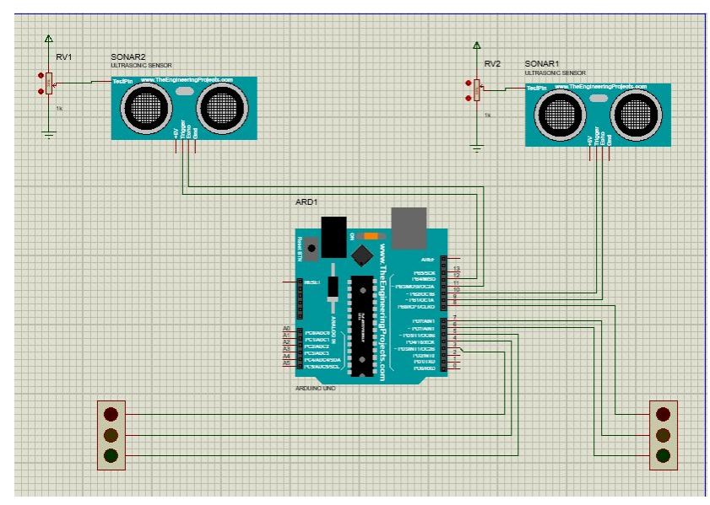

Slide 38
